Slide 1

NATS ATM-UTM
Dr Anthony Rushton (CORUS WP2 lead)
Research & Development
CORUS WP2 Lead
26.11.2018

Slide 2
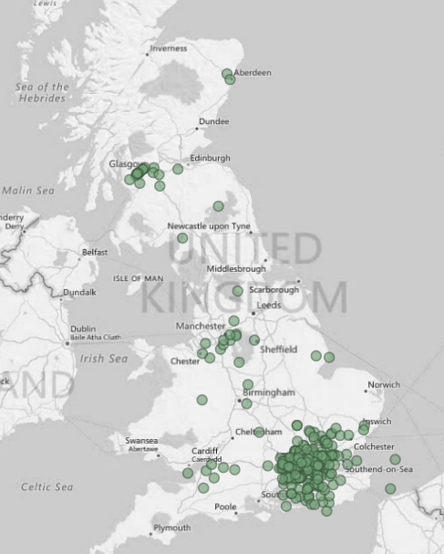
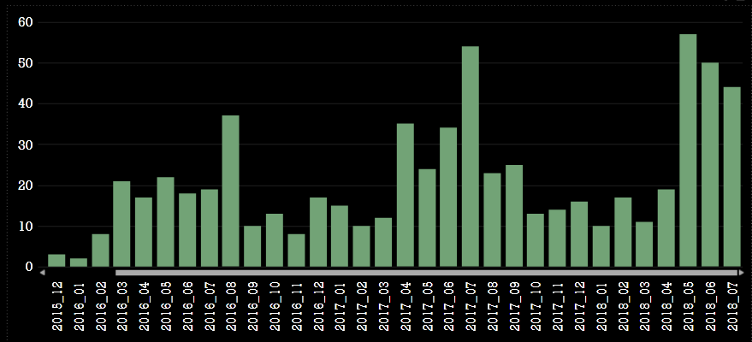
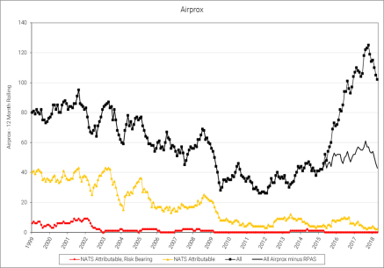
The reality for UK airspace today – infringements & airproxes
Excluding AIRPROX reports classified as Drones related

Slide 3
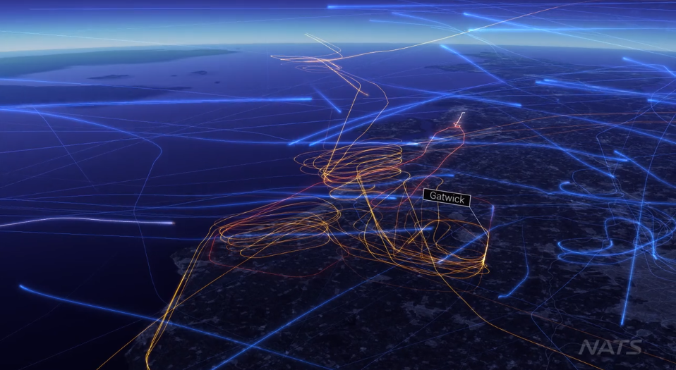
The Impact of Infringements - London Gatwick Airport, 2 July 2017
Incident at 1715-1745
Impact lasted until 2300Hrs
138 flights affected
1618 minutes delays
NATS Vimeo site: www.vimeo.com/228662010

Slide 4
ANSPs in this new economy
ANSPs have a key role in enabling BVLOS UAS operations
ensuring fair and equitable use of the airspace
Integrating unmanned operations in to the airspace
protecting the safety of existing manned aviation customers (manned air traffic is growing too!)
‘Full’ UTM is not yet necessary - ANSPs can leverage existing tools/capabilities, e.g:
Transponder/Surveillance Mandatory Zones and
Traffic Information or Deconfliction service in Class G airspace
Proportionate to socio-economic benefit - not whole of Open FIR
Electronic Conspicuity is key for all airspace users - ADS-B is the initial technology
ANSPs need to move fast to keep pace with needs of early commercial drone operations.
ANSPs are central to establishing BVLOS operations and delivering society benefit
ANSPs can apply existing airspace tools and radar services to enable early delivery
Electronic Conspicuity for all airspace users is key

Slide 5









Project in Brief:
SESAR2020 Exploratory Research project:
Two year duration (mid-2017 to mid-2019)
9 consortium members form CORUS (NATS leads WP2)
21 member advisory board
100+ member U-space Community Network
8 “sibling” projects simultaneously explore technology questions

Slide 6
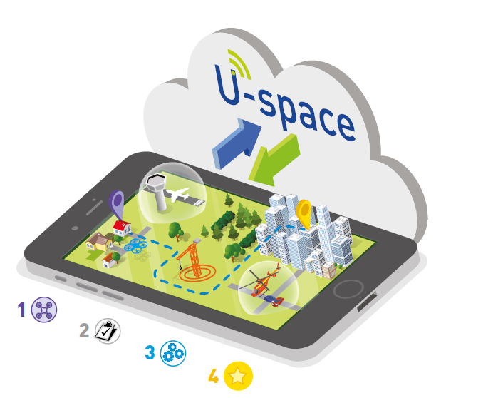
Background – What is UTM / U-space?
UTM = Unmanned air system Traffic Management
U-space = The European ATM-UTM ecosystem
A set of new services & specific procedures to support:
Safe
Efficient
Secure access
…..for a large number of drones.
CORUS is developing this ConOps!

Slide 7

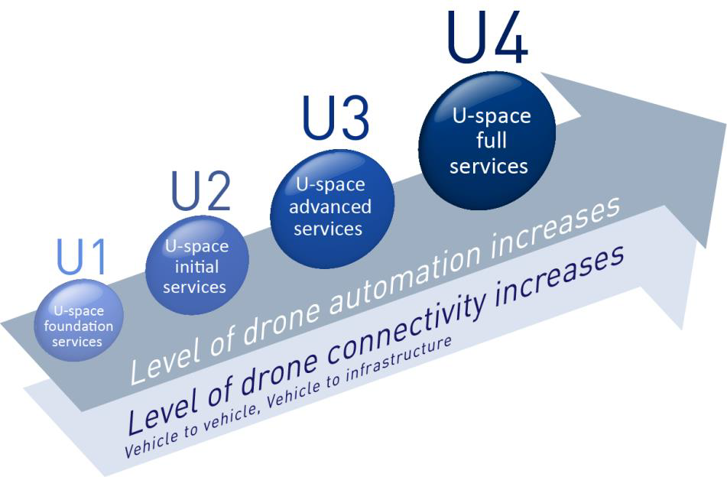
U-space – Deployment Phases
Part of the European ATM MasterPlan
Level | Target
U1 | 2019
U2 | 2022..25
U3 | 2025..30
U4 | 2030+

Slide 8
U-space– Level 1
U1 will be deployed as soon as possible
U1 Focuses on
Registration
Geo-Fencing
E-Identification
U1 requires standardisation and establishment of procedures
Who is responsible for what?
How will things work?
How are geo-fences created?
U1 makes “Open” category VLOS & EVLOS flights relatively easy
U1 high risk flights fly in geo-cage = geo-fence for others
BVLOS, BRLOS, other “Specific” or “Certified”
Geo-cages defined as Danger Areas takes weeks to set up
Level | Target
U1 | 2019
U2 | 2022..25
U3 | 2025..30
U4 | 2030+
Notes:
https://www.eurocontrol.int/sites/default/files/publication/files/corus-concept-of-operations-1.0.pdf

Slide 9
U-space– Level 2
U2 eases Beyond Visual Line of Sight operations
Without requiring geo-fences and the associated notice period
Without requiring detect-and-avoid (i.e. “blind” aircraft)
By means of flight planning and airspace design
U2 allows higher densities of operations than U1
U2 better supports air-risk assessment than U1
By showing traffic demand
U2 includes tracking, monitoring and traffic information
In some airspaces.
In U2 real time information is distributed about emergencies
U2 brings geo-fences with immediate effect
U2 provides support for planned incursions into controlled airspace
E.g. airports
Level | Target
U1 | 2019
U2 | 2022..25
U3 | 2025..30
U4 | 2030+
Notes:
https://www.eurocontrol.int/sites/default/files/publication/files/corus-concept-of-operations-1.0.pdf

Slide 10
U-space– Level 3 & 4
U3 allows higher density operations than U2
U3 is marked by the use of cooperative detect and avoid
U3 brings traffic density management and this allows
Tactical conflict resolution
…meaning automatic provision of separation
U3 provides better support for interaction with ATC
U3 allows drones to made aware of new geo-fences in-flight.
U4 is defined by the safe interoperation of VFR and drones.
Either by all VFR aircraft carrying means to be conspicuous to drones
Or by drones being able to “see” VFR in some way
Plus appropriate rules of the air to allow the safe interactions
Level | Target
U1 | 2019
U2 | 2022..25
U3 | 2025..30
U4 | 2030+
Notes:
https://www.eurocontrol.int/sites/default/files/publication/files/corus-concept-of-operations-1.0.pdf

Slide 11
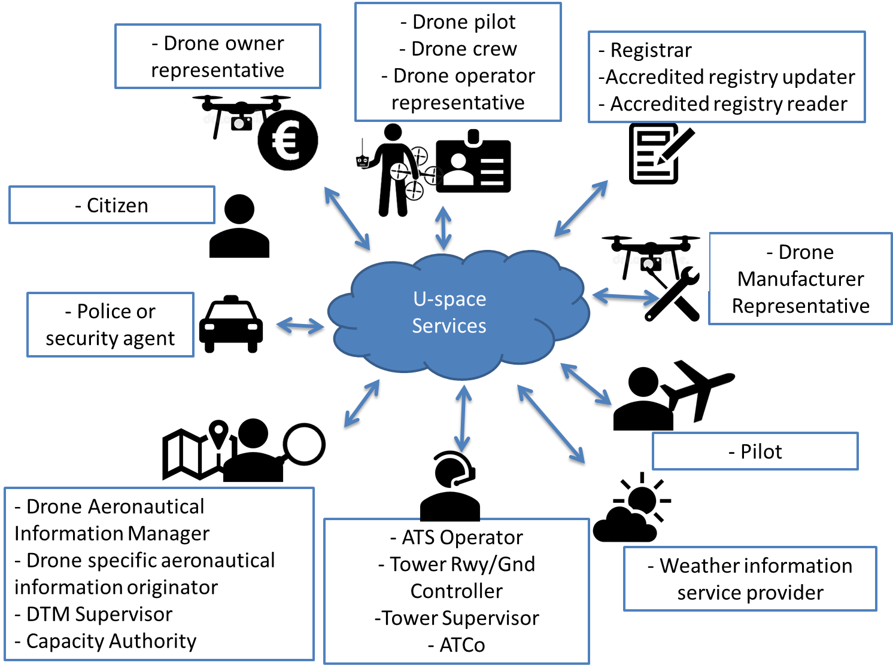
CORUS– High Level Architecture
ConOps defines:
Drone pilot
Drone Crew
Operator
Owner
Register
Authority
Citizen
Etc..

Slide 12
CORUS– High Level Architecture (Monolithic model)

Slide 13
CORUS– High Level Architecture (Federated model)

Slide 14
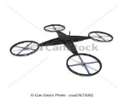


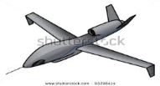

A UTM service framework that supports all users
Existing ATM infrastructure
State/ANSP
Drone registration Access management Airspace definition Conflict management
ATC IFR
Procedural/Technical Integration
UTM core service/data exchange
Open broadcast of flight intent and situational awareness
GA
Service providers
UK MoD
UTM Service Providers
UTM
Service providers
Catalyst for open competition downstream
Shared access to airspace by all users

Slide 15
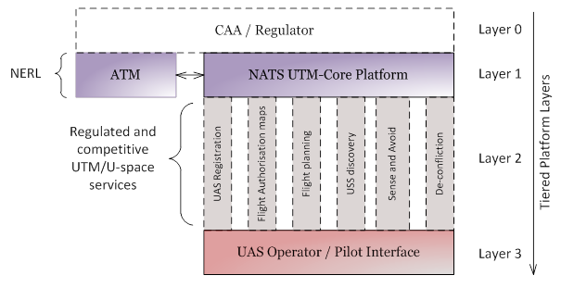
UTM Core Architecture

Slide 16
Benefits of ANSP-provided Regulated UTM Services
Proposed regulated ANSP UTM service
User registration, on-line training and education
Publication and management of drone no-fly zones
Real time flight planning and airspace approval
Pre-flight and real time notifications
Tracking and monitoring
Interface with existing ATC operations
Benefits to existing customers
Reduced risk of infringement of drones into controlled airspace
Improved understanding of drone pilot intent and thus less disruption
Registration allows enforcement that in turns acts as a deterrent
Avoidance of additional cost to manage safety impact
Benefits to airports
Improved understanding of drone pilot intent and thus less disruption
More accurate picture of actual safety risk and disruption at airports
System for allowing delegated control of airspace
Avoidance of increased tower workload
Benefits to new airspace users
Improved safety in uncontrolled airspace due to awareness of flight intent and electronic conspicuity
Assists co-ordination of critical services (eg emergency services) in uncontrolled airspace
Maintain safe operation of military flights in shared airspace

Slide 17
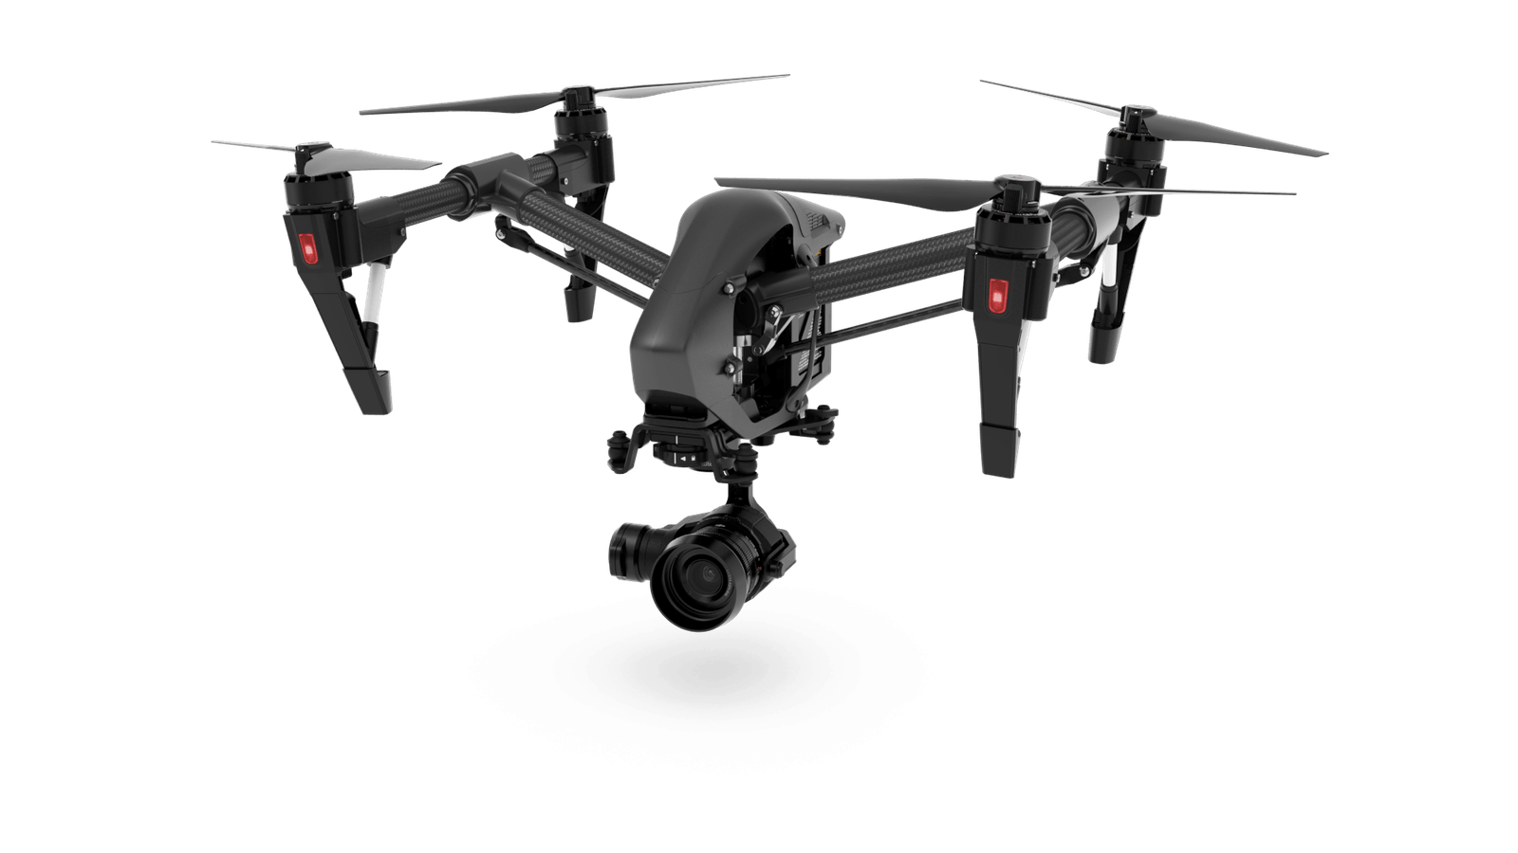
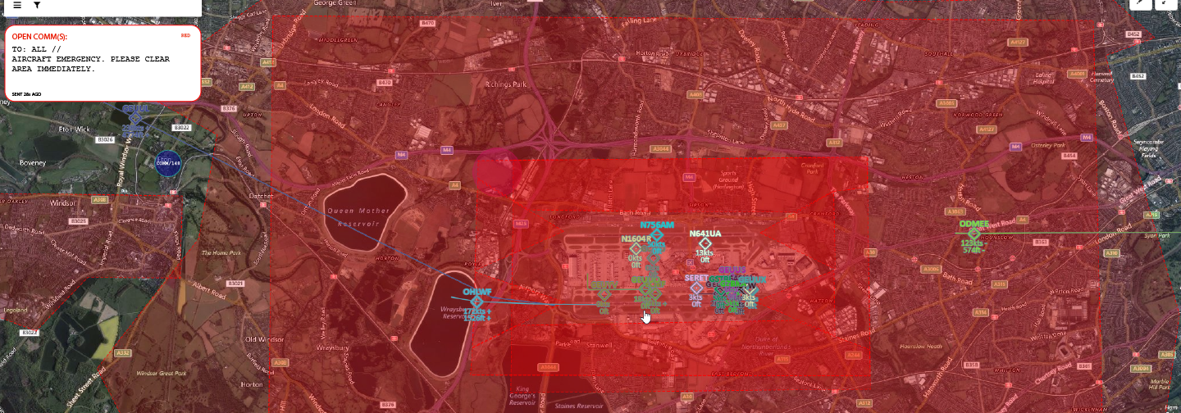
Thanks for your attention
Anthony Rushton – Lead UTM R&D
Anthony.Rushton@nats.co.uk

